Slide 1

DriverPass System Analysis
Ryan P. Gingery
Notes:
[No speaker notes required for this slide.]

Slide 2

System Requirements
Functional Requirements:
Online Practice Exams
Appointment Scheduling
Nonfunctional Requirements:
System Maintenance
System Security
Notes:
Two functional requirements that will be absolutely necessary for DriverPass will be online practice exams and appointment scheduling. Online practice exams are a functional requirement for DriverPass as this is part of their entire idea of the system. The requirement to allow students to practice their exams online is absolutely crucial to the idea and success of DriverPass. The second functional requirement is the ability for the students/customers to schedule appointments online themselves for their driving appointments with selected instructors. This is once again another aspect that DriverPass pointed out was a necessity for the system. While students may call to schedule appointments with the secretary, the functional requirement may extend to them as well as they must also have the ability to schedule desired appointments for the customers within the system itself.
The two nonfunctional requirements for the DriverPass system would be system maintenance and system security. While these two areas are ultimately still important overall to the DriverPass system, they are not a requirement for the functionality of DriverPass.
[In your speaker notes, include an explanation of the different requirements you determined for DriverPass’s system. What are the functional requirements you selected to describe? What are the nonfunctional requirements you selected to describe? Be sure to explain how these requirements meet DriverPass’s needs.]

Slide 3
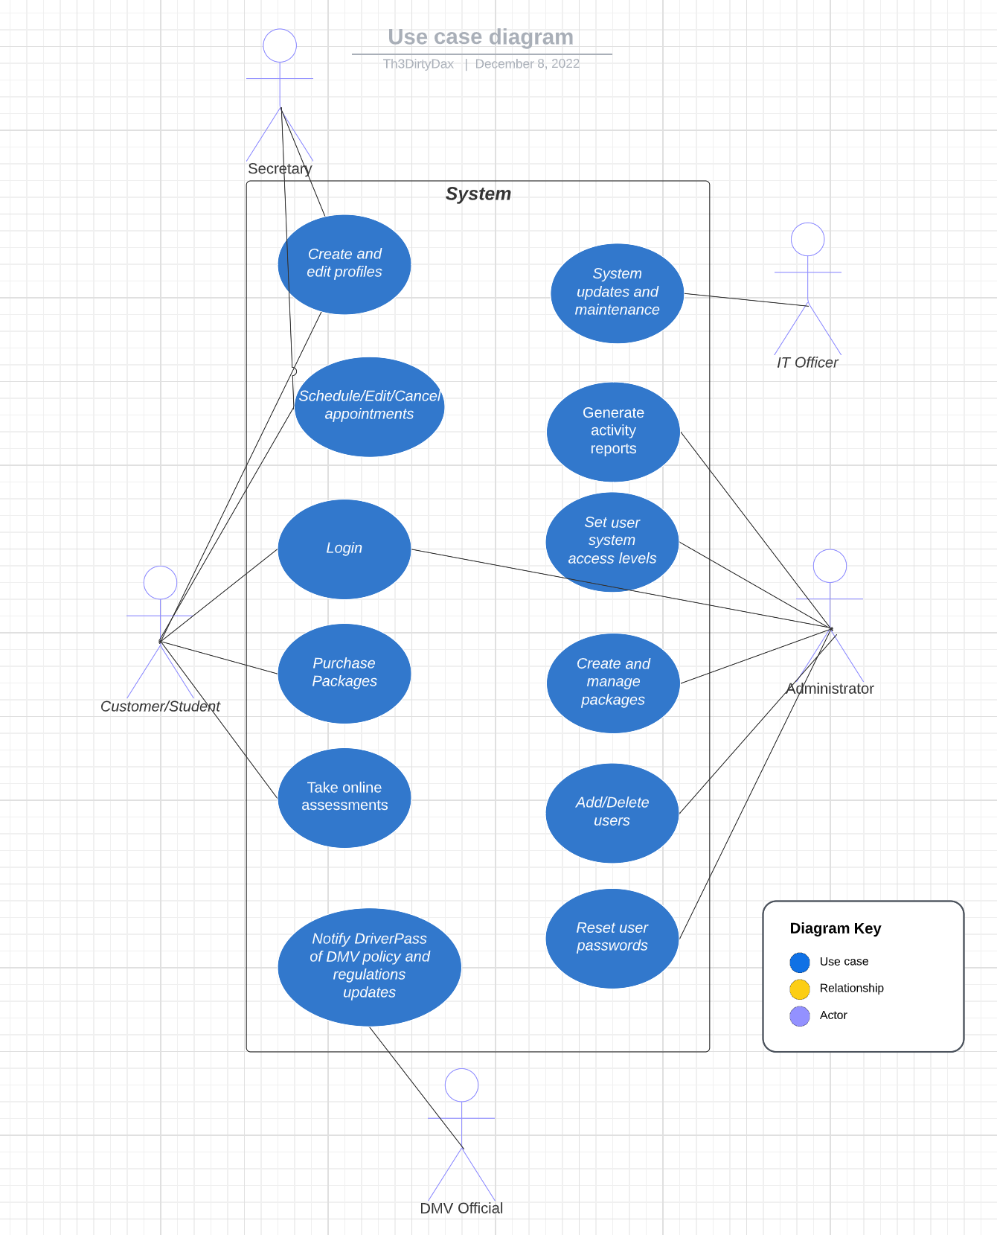
Use Case Diagram
Notes:
The actors that will make up the DriverPass system will be the customer/student, the secretary, the IT Officer, the administrator, and the DMV official. Each of these users will serve their own roles and occasionally have overlapping privileges. As you can see, the secretary shares the same abilities as the customer. The secretary, per DriverPass requests, should have the ability to schedule appointments for students who call or come-in in person and they should also be able to create user accounts for new students. The students need to ability to login, take exams, schedule appointments, and purchase driving packages. The DMV Official will have the ability to send updates on DMV policies and regulations. The IT Officer needs to be able to conduct system maintenance and updates to ensure software security remains relevant. Then, lastly, the administrator, needs to be able to manage full access to the system. They need to be able to generate and pull reports for user activity and progresses, set access levels for new users added to the system, create and manage new packages and deals being offered by the DriverPass system. They also need to be able to reset passwords for users who have been locked out or forgotten their passwords.
[Explain your diagram. Who are the different actors in the system? What are the different use cases? How did you account for DriverPass’s needs in your design? In your explanation, keep your audience in mind. Avoid the use of terms like “actors” and “use cases” in your explanation.]

Slide 4
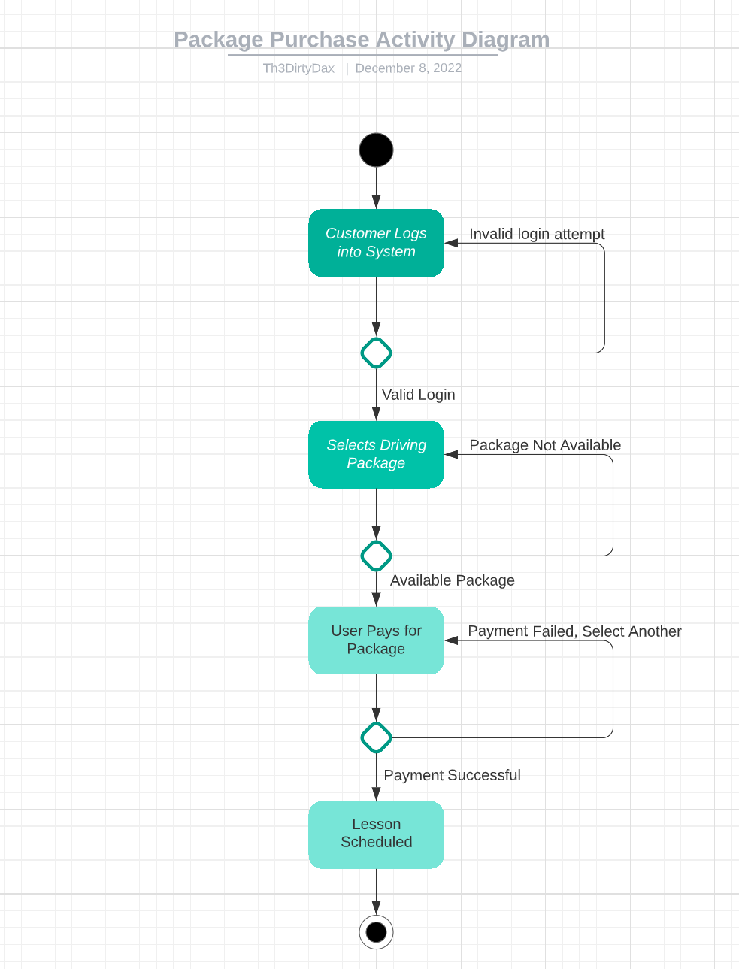
Activity Diagram
Notes:
This diagram is breaking down the flow of a customer purchasing one of the packages that DriverPass is offering. The flow of the diagram will be that the customer logs into the system, if the login is invalid, they will be notified and prompted to try again until they succeed or lock their account. Once they successfully sign in, they will then be able to navigate the to DriverPass packages section to view and select their desired package. If they attempt to select a package that is no longer offered then they will be notified. This should not occur as DriverPass will be taking down packages that are not offered rather than leaving them on the system, however, it has been adjust incase this slips through the cracks. Once they have selected their package they will then proceed to checkout. Once again, they will be prompted of an invalid attempt if the payment method was incorrect in anyway. Once successful, they payment will process and the customer may then begin scheduling their appointments with their designated driving instructor.
[Explain your diagram. Which use case are you breaking down? What are the steps for this use case? How did you account for DriverPass’s needs in your design? In your explanation, keep your audience in mind. Avoid the use of technical terms such as “nodes,” “control flows,” and so on.]

Slide 5
Security
Username and Password for Logon
3 failed attempts results in user being locked out
Two-Factor Authentication (if desired)
Administrator authorization of user roles and management
Employee/Customer information confidentiality
IT Officer conducts routine maintenance and system upgrades to keep software relevant
Notes:
The design of the system will ensure that several security protocols are implemented to help keep DriverPass secure. Beginning with user login credentials. Users will create their own usernames and passwords, they will also be prompted to use two-factor authorization for their own safety as well. User account being locked out after 3 failed login attempts is another security measure to help ensure that unauthorized users are not gaining access to someone's account through unlimited login attempts. To help keep user accounts safe, users must require a password reset from system administrators rather than simply doing it themselves.
Administrators will be able to set access permissions for each user based on their needs and roles within the system. This will add another layer of security by ensuring that users do not gain more accesses than are needed or required for their roles. Information being transmitted between systems will be encrypted so that the information is not on display for the world to see as the data is sent from the servers to the users, and back.
The final stretch of security will be the IT Officers conducting routine maintenance to the system and cleaning out any cache buildups that are not required and removing unwanted data. They will also conduct routine updates to the systems to help ensure that the software and technology remain up-to-date and relevant, as outdated software and hardware can increase the chances of a successful attack.
[How did you consider security in your design? In your explanation, keep your audience in mind by avoiding the use of technical terms.]

Slide 6
System Limitations
Computers and Mobile devices only
System will ultimately require internet to properly make appointments and account updates
Clients time and budget
Exams and Driving practices rely on DMV regulation updates to be accurate
Only 10 cars currently available
Notes:
The limitations of the DriverPass system will be that it is only accessible from computers or mobile devices, you cannot access DriverPass from random consoles such as a gaming console. In order for user data to update and generate properly, internet will be required to use the system. The student may download exams, but their profile will not update until they are back online. Appointments on the system also cannot be made without either the student or secretary having the internet access to make them.
A limitation for any all systems will be the clients budget and schedule. If there are factors that wish to be added but the budget and schedule do not allow for it, then it cannot be added in the initial process of DriverPass. The exams and driving instructors information is based on accurate updates from the DMV. If these updates are not recognized accordingly, then students will be given outdated instruction and information.
Lastly, the fact that DriverPass currently only has 10 available cars for drivers and students will limit their ability to make many appointments. While this project is new it is understandable, but if there is a large amount of students who rush to the system at once, the schedules will be filled quickly meaning DriverPass may have to look to more cars in the future if this becomes very successful.
[What are the limitations of your design? In your explanation, keep your audience in mind by avoiding the use of technical terms.]

